Slide 1


An Introduction to
Autism

Slide 2
WHAT IS AUTISM
Autism (or Autism Spectrum) is a neurodevelopmental difference in how the brain processes information, senses, and social interaction.
It is a spectrum—support needs range from minimal to substantial.
Identity language: Both “autistic person” (identity‑first) and “person with autism” (person‑first) are acceptable; follow the individual’s preference
Notes:
Visual: A spectrum bar showing “Different wiring, same value.”
Speaker Note: Frame autism as a natural variation of human neurology, not a disease to be cured.

Slide 3

What Is Autism?
Autism is a ‘hidden disability’, meaning it is not easy to recognise when someone has the condition. When you see the following pattern (on a wristband, card or mobile device) it means someone has autism and wants you to know so that you can support them:
Autistic people often have difficulty in accessing community activities, leisure facilities and other services. Everyone having a better understanding of autism has the power to change lives. The following information is provided to help you to gain a better understanding of autism and suggests ways in which you can support autistic people.
For more information on the ‘Can You See Me?’ scheme, please visit:
https://www.asdinfowales.co.uk/can-you-see-me

Slide 4
What Is Autism?
Autism is also known by other names, including:
Autism Spectrum Disorder (ASD)
Asperger’s Syndrome
Autistic Spectrum Condition (ASC)
Pervasive Developmental Disorder

Slide 5
What Is Autism?
Autism is a lifelong condition and affects people from all backgrounds.
Currently more males than females are diagnosed with autism.
It is estimated that 1 in every 100 people in the UK have an Autism Spectrum Disorder (ASD).
Many people are unaware that they are autistic.
This is especially true for adults.

Slide 6
WORLDWIDE
~1 in 36 children in the U.S. diagnosed (CDC, 2023).
All genders, races, and socioeconomic groups—though diagnosis rates differ due to access and bias.
Adults: Many remain undiagnosed, especially women, non‑binary folks, and those with higher support needs who mask.

Slide 7





What Is Autism?
Autistic people have differences in the following areas:
Social Communication &
Social Interaction
Social Imagination and Flexibility of Thought
Restricted, repetitive interests or activities
Restricted, repetitive patterns of behaviour
Unusual sensory responses

Slide 8
CAUSES
Autism is biological and multifactorial—no single cause.
Genetics: Strongest factor; dozens of gene variants can increase likelihood (heritability ~80‑90%).
Prenatal environment: Interaction of genes + factors like advanced parental age, certain prenatal conditions (not caused by parenting style).
Brain development: Differences in connectivity and sensory processing from early development.
Vaccines do NOT cause autism—extensive global research confirms this.
Notes:
Visual: A Venn diagram: Genetics + Environment + Development = Autism.
Speaker Note: Reassure audience: Parents do not cause autism; focus on acceptance, not blame.
HERITABILITY │
│ • If one identical twin has autism, │
│ the other has 60-90% chance of ASD │
│ │
│ • If one sibling has autism, │
│ risk for next sibling is ~20% │
│ │
│ GENE MUTATIONS │
│ • Over 100 genes have been linked │
│ to autism │
│ • Some are inherited, some occur │
│ spontaneously (de novo mutations) │
│ │
│ ASSOCIATED CONDITIONS │
│ • Fragile X Syndrome │
│ • Tuberous Sclerosis │
│ • Rett Syndrome │
│ • Down Syndrome (co-occurring)

Slide 9
MYTHS
Myth | Reality
“Bad parenting” causes autism. | False. Autism is neurobiological.
“All autistic people have savant skills.” | False. Strengths vary; most have everyday skills and talents.
“Autism only affects children.” | False. It is a lifelong identity; support needs change over time.
“You can “outgrow” autism.” | False. Support strategies evolve, but autism is enduring.

Slide 10

Social Communication & Social Interaction

Slide 11
Social Communication & Social Interaction
Autistic people experience social communication differences.
The way this affects a person can vary, and can include difference in the use and understanding of:
speech
language
gestures
tone of voice
eye contact

Slide 12
Understanding Support Levels (Not “Types”)
Level | Support Needed | Example
Level 1 (“Requiring Support”) | Noticeable differences; may mask/camouflage. Struggles in unfamiliar settings or with change. | Needs clear instructions, sensory breaks, advance notice.
Level 2 (“Requiring Substantial Support”) | Marked difficulty with verbal/non‑verbal communication; obvious sensory distress. | Needs structured routines, visual supports, explicit teaching.
Level 3 (“Requiring Very Substantial Support”) | Significant support across all domains; limited speech or very restricted interests. | Needs high staff-to-individual ratio, specialized communication systems.

Slide 13
Social Communication & Social Interaction
How this impacts on day to day life:
People often use body language and sarcasm to convey something.
Autistic people often find these difficult to understand.
Autistic people may be perceived as rude because they avoid eye contact.
Their tone of voice may not always reflect the way an autistic person is feeling.
An autistic person may not be able to use gestures or interpret other people’s gestures.
Autistic people may interpret language literally and so may misunderstand idioms (“pull your socks up”) and metaphors (“my head was spinning”).

Slide 14
Core Characteristics
Sensory: Over‑ or under‑sensitivity to sound, light, touch, smell, taste, or pain.
  Example: Fluorescent lights feel like “buzzing knives”; soft fabrics may feel scratchy.
Repetitive behaviours/interests: Stimming (hand‑flapping, rocking) = self‑regulation, not “bad behaviour.”
Routine & predictability: Need for sameness reduces anxiety; sudden changes can be distressing.
Notes:
Visual: Icons for senses (ear, eye, hand) with sliders showing “too much / just right / too little.”
Speaker Note: Stimming is helpful. Only intervene if it causes harm; otherwise, respect it.

Slide 15
Social Communication & Social Interaction
Autistic people experience social interaction differences.
The way this affects a person can vary, and can include difference in the use and understanding of:
engaging in conversation
building and sustaining relationships
understanding humour
giving and receiving compliments
showing concern for others

Slide 16
Social Communication & Social Interaction
How this impacts on day to day life:
Autistic children may find it difficult to instigate or join in play with other children.
Autistic children may find it difficult to take turns and share.
This can cause problems with friendships.
Developing and maintaining friendships and relationships can be difficult for everyone.
Autistic adults have told us that they find this particularly difficult.
This does not mean that they do not want relationships and friends.
Autistic people may not engage in conversation in the same way, and enjoy discussing factual issues rather than small talk.
You may have to be specific when you want to bring the conversation to end.
Autistic people may have difficulty in understanding the rules of social relationships.
This may cause many issues including them offering truthful opinion rather than a tactful one.

Slide 17

Social Imagination and Flexibility of Thought

Slide 18
Social Imagination and Flexibility of Thought
Impairments in social imagination
Autistic people experience social imagination differences.
The way this affects a person can vary, and can include difference in the use and understanding of:
predicting reactions and events
problem solving
relating to others
coping with changes
planning

Slide 19
Social Imagination and Flexibility of Thought
How this impacts on day to day life:
When problem solving, we rely on our social imagination to predict possible outcomes.
This is difficult for an autistic person.
Playing team games often relies on social imagination to predict how other people will interact in the game.
This can be difficult for autistic people.
Autistic people may find it difficult to predict how others may be feeling or how they will react due to problems with social imagination.
Some autistic people have difficulties with creative imagination.
Others have good creative imagination, and only the social imagination is affected.
Planning can be difficult without good social imagination, autistic people often use calendars or planners to help them with this.
Coping with changes can be difficult without good social imagination.
Autistic people usually prefer routines to unpredictability.

Slide 20
ACROSS LIFETIME
Stage | Common Presentation
Early Childhood | Delayed speech, intense focus on parts of objects, sensory meltdowns.
School Age | Bullying sensitivity, need for special interests, executive‑function challenges (planning, transitions).
Adolescents/Young Adults | Masking peaks; mental‑health challenges (anxiety, depression); questions about identity.
Adults | Workplace accommodation needs, deep expertise in niche areas, desire for genuine relationships.

Slide 21
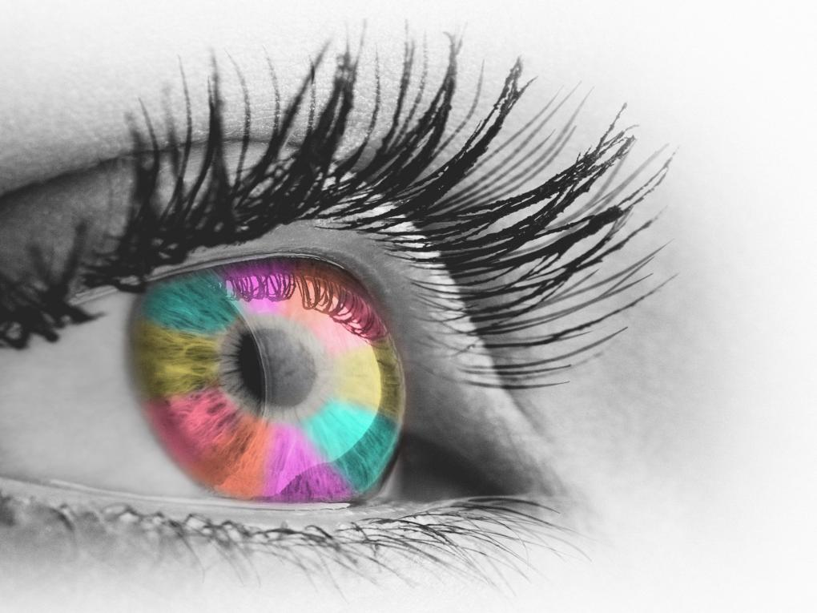
Unusual Sensory Responses

Slide 22
Unusual Sensory Responses
Many autistic people can have sensory issues.
The person’s perception of the senses can be heightened or decreased. All the senses can be affected.
tactile
  (touch)
vestibular
  (movement)
proprioceptive
  (body position)
visual
  (looking)
auditory
  (hearing)
olfactory
  (smell)
gustatory
  (taste)

Slide 23
Unusual Sensory Responses
How this impacts on day to day life, both positively and negatively:
Sensory joy from certain colours
Sensory joy from the feel of certain materials – “stimming”
Decreased feelings of pain
Sensitivity to lighting in shops
Dislike of certain colours
Difficulties around noisy traffic
Inability to tolerate certain smells
Distress/anxiety in busy environments
Sensitivity to touch

Slide 24
STRENGTHS AND SURPRISES
Special Interests = Superpowers: Deep, passionate knowledge that drives innovation (tech, art, science, memory, systems).
Honesty & Loyalty: Often incredibly trustworthy, rule‑following, and detail‑oriented.
Sensory Superpowers: Some hear higher frequencies, notice patterns, or have exceptional visual memory.
Neurodiversity in Nature: Autism is not “broken”; it’s a different operating system—like being left‑handed in a right‑handed world.

Slide 25
What Is Autism?
How you can help:
Being aware of Autism and the differences experienced by autistic people is key.
Ask the autistic person, carers or seek advice from others.
Be understanding, people with autism have a lot to offer but may need support.
Consider how you can adapt the environment to decrease sensory issues (decrease noise, dim lighting, find a quiet space etc.)
Adapt your communication style.

Slide 26
Adapt Your Communication
Communication - adapting your communication can help an autistic person:
Speak slowly and clearly
Allow time for the person to process information
Avoid relying on gesture, facial expression or tone of voice
Don’t use idioms or metaphors
Keep instructions short

Slide 27
COMMUNICATION
✅ Be clear and literal. “Can you file this by 3 PM?” vs. “Maybe you could…?”
✅ Give processing time. Don’t rush answers; silence is okay.
✅ Confirm understanding. “I heard you say X—did I get that right?”
✅ Use multiple formats: words + visuals + demonstrations.
Don’t:
❌ Rely on sarcasm, idioms, or “reading between the lines.”
❌ Interrupt or finish sentences (unless asked).
❌ Assume lack of response = lack of understanding.

Slide 28
Best Ways to Support: Strengths‑Based Accommodations
Focus on what works, not just deficits.
Leverage special interests: Assign projects related to their passion (e.g., trains, coding, animals).
Structured tasks: Clear step‑by‑step instructions; checklists.
Executive‑function support: Break big tasks into chunks; use timers or apps.
Mentorship & safe relationships: Pair with an ally who listens without judgment.

Slide 29
ENVIRONMENT
Create Predictable, Low‑Stress Spaces:
Sensory: Dim lights, noise‑cancelling options, quiet zones, allow stimming.
Predictability: Visual schedules, advance warnings for changes (“In 5 minutes we transition”).
Choice & Control: Offer options (“Do you want to work at the desk or the standing table?”).
Minimize surprises: Share agendas ahead of meetings; avoid sudden loud noises.
Notes:
Visual: Icons for “quiet room,” “visual schedule,” “choice board.”
Speaker Note: Small environmental tweaks prevent meltdowns/burnout and boost wellbeing.

Slide 30
BE INCLUSIVE
For Schools, Workplaces, or Community Groups:
Ask, don’t assume. “What support would help you succeed?”
Train staff/team on neurodiversity and implicit bias.
Review policies: Are they flexible for sensory needs or different communication styles?
Celebrate neurodiversity in events and materials (not just “awareness,” but acceptance).
Review physical space: Is there a low‑stimulation area

Slide 31
DO’S AND DONTS
✅ Do | ❌ Don’t
Respect stimming unless harmful. | Force eye contact or “stop flapping.”
Use clear, kind language. | Use sarcasm, teasing, or vague hints.
Offer choices and advance notice. | Spring surprises or sudden changes.
Focus on strengths and interests. | Define the person only by challenges.
Listen and believe lived experiences. | Dismiss sensory pain (“It’s not that loud”).

Slide 32
KEY TAKEAWAYS
Autism is a natural neurological difference, influenced by genetics and environment—not caused by parenting or vaccines.
Support needs vary (Levels 1‑3); understand the person, not the label.
Sensory and communication differences are real and impact daily life—accommodations matter.
Autistic people have unique strengths; inclusion benefits everyone.
Support = Acceptance + Practical Accommodation.

Slide 33

Further Information
For further information on autism, please watch the ‘What Is Autism?’ film by visiting:
www.vimeo.com/339305728
To complete the questionnaire and to get your personalised Autism Awareness certificate, please visit:
www.ASDinfoWales.co.uk/asdaware
You can also apply to become an Autism Aware organisation. For more information, please visit:
www.ASDinfoWales.co.uk/asd-aware-organisations

Slide 34




Further Information
For information on the SIGNS of autism, please visit:
www.ASDinfoWales.co.uk/autismchildsigns and www.ASDinfoWales.co.uk/recognise-asd-adult
Further information and links to other resources can be found at:
or email enquiries to ASDinfo@WLGA.gov.uk
ASDinfoWales
@ASDinfoWales

