Slide 1

LEARNING DISABILITY AND LEARNING DIFFICULTIES
GARY WOODWARD GCARE CONSULTANTS

Slide 2
The difference between a learning difficulty and learning disability
Distinguishing between learning difficulties and learning disabilities is quite a complex issue.
A learning difficulty does not affect general intelligence, whereas a learning disability is linked to an overall cognitive impairment.

Slide 3

Learning Difficulties

Slide 4
Learning Difficulties
Unlike a learning disability, a learning difficulty does not affect general intelligence (IQ). An individual may often have more than one specific learning difficulty (for example, dyslexia and dyspraxia are often encountered together), and other conditions may also be experienced alongside each other.

Slide 5

Learning Difficulties
Some examples of specific learning difficulties are:
Attention Deficit Hyperactivity Disorder (ADHD)
Dyspraxia
Dyslexia

Slide 6
Learning Difficulties
There is no definitive record of how many people in the UK have learning difficulties. This is largely because most learning difficulties are ‘hidden’ disabilities, meaning that the condition is not immediately obvious to others, or even to the person themselves.
Below are some of the estimated numbers of people affected by some of the most common learning difficulties:
Approximately 10% of the population are affected by dyslexia to some extent.
Dyspraxia affects between 5 and 10% of the population to some extent, with around 2% being affected severely.
Attention deficit hyperactivity disorder (ADHD) affects approximately 3–9% of school-aged children and young people, with around 1% being affected severely.

Slide 7

Learning Difficulties - ADHD
Attention deficit hyperactivity disorder (ADHD) is a learning difficulty caused by a neurobehavioural disorder, and is the most commonly diagnosed psychiatric disorder in children.
Attention deficit disorder (ADD) is a subtype of ADHD. The term ‘ADD’ was formally changed in the Diagnostic and Statistical Manual of Mental Disorders, fourth edition (DSM-IV) to ‘ADHD predominantly inattentive’, although ‘attention deficit disorder’ remains widely used.
Symptoms often found include the following:
Short attention span, or being easily distracted
Restlessness, or constant fidgeting
Hyperactivity
Impulsiveness

Slide 8
Learning Difficulties - ADHD
Many people with ADHD also experience additional problems such as sleep disorders, and may have further learning difficulties caused by their difficulty with holding attention.
ADHD has no effect on intelligence, but some people with a learning disability may also have ADHD.
Children will usually be diagnosed by a psychiatrist or psychologist, based on specific criteria. Adults are harder to diagnose because there is no definitive set of age-appropriate symptoms. Approximately two in five children with ADHD will continue to have difficulties past the age of 18.

Slide 9
Learning Difficulties - ADHD
How it affects people
The effects of ADHD on children can be very disruptive at both school and home. While their intellect may be normal or advanced, more than half of children with ADHD have additional specific learning difficulties, such as dyslexia.
People with ADHD may experience low self-esteem or underachievement due to the difficulties involved in managing their symptoms.
They are also more likely to be depressed, anxious, or obsessive, and they may have problems with speech, language and coordination.
People with ADHD need high levels of stimulation, so often find working in a constantly-moving environment beneficial.

Slide 10
Learning Difficulties - ADHD
How many people have Attention Deficit Hyperactivity Disorder?
It is estimated that the condition affects 2-5% of school-aged children and young people. It is up to four times more common in male children than in female children.
Our work at the Foundation focuses primarily on people with learning disabilities as opposed to people with specific learning difficulties. For more information about this condition we suggest you contact an organisation which specialises in these conditions, like the National Attention Disorder Information Support Service.

Slide 11
Learning Difficulties - DYSPRAXIA
Dyspraxia is usually recognised as being an impairment or ‘immaturity’ of movement control. There is no known cause, although some research suggests that it may be linked to neuron development.
Its effects are caused by messages not being properly or fully transmitted by the brain. Dyspraxia affects the planning of future acts, and is associated with problems of perception, language and thought.
There is a lot of overlap between the signs and symptoms of dyspraxia and dyslexia.

Slide 12
Learning Difficulties - DYSPRAXIA
It's rare for an individual to be affected by a single learning difficulty. People will usually have two or more simultaneous conditions, ranging from mild to severe. For example, research suggests that 52% of children with dyslexia also have features of dyspraxia, and up to 50% of people with dyspraxia will also have ADHD

Slide 13
Learning Difficulties - DYSPRAXIA
How it affects people
The term dyspraxia is used to describe a set of symptoms. Typical ways in which dyspraxia may affect people include the following:
Movements such as running, jumping and balancing are difficult to control.
Movements can be slow and hesitant, and are not picked up instinctively.
A lack of confidence in tackling new skills.
The control of fine motor skills such as writing and art work are usually more difficult.

Slide 14
Learning Difficulties - DYSPRAXIA
Problems with conceptual skills can occur. These may include mastering jigsaws and sorting games when young, and analysing scientific or mathematical problems when older.
Routine’ tasks such as driving, household chores, cooking and self-grooming may present greater difficulties.
There is no cure for dyspraxia, but a number of therapies can make it easier for the child to cope with their problems.
Speech and language therapy can aid in improving speech and communication skills, and occupational therapy can aid in finding ways to remain independent in completing everyday tasks.

Slide 15
Learning Difficulties - DYSLEXIA
Dyslexia is a common learning difficulty that can cause problems with reading, writing and spelling.
It's a "specific learning difficulty", which means it causes problems with certain abilities used for learning, such as reading and writing. Unlike a learning disability, intelligence isn't affected.

Slide 16
Learning Difficulties - DYSLEXIA
It's estimated that up to 1 in every 10 to 20 people in the UK has some degree of dyslexia.
Dyslexia is lifelong problem that can present challenges on a daily basis, but support is available to improve reading and writing skills and help those with the problem be successful at school and work

Slide 17
Learning Difficulties - DYSLEXIA
What are the signs of dyslexia?
Signs of dyslexia usually become apparent when a child starts school and begins to focus more on learning how to read and write.
A person with dyslexia may:
read and write very slowly
confuse the order of letters in words
put letters the wrong way round – such as writing "b" instead of "d"
have poor or inconsistent spelling
understand information when told verbally, but have difficulty with information that's written down
find it hard to carry out a sequence of directions
struggle with planning and organisation

Slide 18

LEARNING DISABILITIES

Slide 19
Learning Disabilities
What is a learning disability?
Having a learning disability means that people find it harder to learn certain life skills. The problems experienced vary from person to person, but may include aspects such as learning new things, communication, managing money, reading, writing, or personal care. Some people are born with a disability, whereas others may develop one as a result of an accident or illness in childhood.

Slide 20
Learning Disabilities
Types of learning disabilities differ hugely. Someone with mild disabilities may be able to live independently with minimal support, whereas someone with severe and profound disabilities may require 24 hour care, and help with performing most daily living skills.
A learning disability is defined by the Department of Health as a “significant reduced ability to understand new or complex information, to learn new skills (impaired intelligence), with a reduced ability to cope independently (impaired social functioning), which started before adulthood” (Department of Health, 2001).

Slide 21
Learning Disabilities
Sometimes, the term 'Global Developmental Delay' (GDD) is used to describe a learning disability. GDD describes a condition that occurs between birth and the age of 18 which prevents a child from reaching key milestones of development like learning to communicate, processing information, remembering things and organising their thoughts.

Slide 22
Learning Disabilities
What causes a learning disability?
Learning disabilities are caused by something affecting the development of the brain. This may occur before birth (prenatally), during birth, or in early childhood.
Learning disabilities can be caused by any one of a variety of factors, or by a combination. Sometimes the specific cause is not known. Possible causes include the following:

Slide 23
Learning Disabilities
What causes a learning disability?
An inherited condition, meaning that certain genes passed from the parents affected the brain development, for example Fragile X
Chromosome abnormalities such as Down’s syndrome or Turner syndrome
Complications during birth resulting in a lack of oxygen to the brain
A very premature birth
Mother’s illness during pregnancy

Slide 24
Learning Disabilities
An inherited condition, meaning that certain genes passed from the parents affected the brain development, for example Fragile X
Chromosome abnormalities such as Down’s syndrome or Turner syndrome
Complications during birth resulting in a lack of oxygen to the brain
A very premature birth
Mother’s illness during pregnancy
Some people with learning disabilities have additional physical disabilities and/or sensory impairments

Slide 25
Learning Disabilities
How many people have a learning disability?
It has been estimated that 1.5 million people in England (2% of the population) have a learning disability.
The numbers known to learning disability services are much smaller: an estimated 346,235 people.
Figures taken from The Improving Health and Lives Learning Disabilities Observatory (IHAL), 2013

Slide 26
Learning Disabilities
How does a learning disability affect a person’s life?
People with learning disabilities do not learn certain skills as quickly as other people and may therefore need extra help in certain aspects of their lives. The specific skills in question will depend upon the type of disability. People with mild learning disabilities may live alone, travel independently, and work. They may not require any support from their local authority, or may just need support in managing their finances. Other people may require more regular support to ensure their safety and health on a daily basis. Those with more severe or complex needs may need extensive, hour-to-hour help in performing basic skills, such as eating, dressing and washing.

Slide 27
Learning Disabilities
What is the difference between a learning disability and a mental health problem?
A learning disability is a permanent condition developing at the latest in early childhood, whereas mental illness (or a mental health problem) can develop at any time, and is not necessarily permanent. People can get better and resolve mental health problems with help and treatment.
Whilst mental health problems can be treated through therapy, social support, medication, or a combination of these, people with learning disabilities are not ‘treated’ but rather receive support which enables them to most effectively and happily lead their lives. Anyone can develop a mental health problem at any stage of their life, which means that they must be given the necessary support to deal with it, and ideally to prevent it from occurring at all

Slide 28
Learning Disabilities
People with a learning disability are a very diverse group
A person with a learning disability is someone who, from childhood, has had difficulty in learning and processing information so that it significantly reduces his or her ability to carry out the full range of everyday tasks. The term ‘learning disability’ is only used in the UK – other countries use ‘intellectual disability’ or ‘mental retardation’.
People with a learning disability are a very diverse group with a wide range of abilities. A person with a ‘mild learning disability’ may live in their own house (or in a house shared with other people), work, and raise children. They will probably need advice and support in these tasks from time to time. By contrast, someone with a ‘severe or profound learning disability’ will probably be unable to use speech, may be incontinent and physically-disabled and require 24 hour care

Slide 29
Learning Disabilities
Communication is the key to effective support
Many people with a learning disability experience problems in communicating. They may have limited vocabulary and understanding of grammar, problems in articulating words, or no understanding of speech at all. But almost all are capable of communicating. Those with limited speech are usually able to use visual signs and symbols, while even those with the most profound learning disability are able to express pleasure and distress. Even when people are unable to express speech, they may be able to understand some words. The main problem for many people with a learning disability is that those they wish to communicate with often lack the time and commitment to understand their particular style of communication.

Slide 30
Learning Disabilities
Many people with a learning disability have unmet health needs
Most people with a learning disability have chronic disorders, illnesses or disabilities in addition to the learning disability itself. They are at much greater risk of injuries than the general population because they often have less capacity to assess risk, and have high rates of epilepsy, sensory impairments and mobility problems. They are four times more likely than the rest of us to suffer from anxiety and depression, which may result from the stress they experience in coping with dependence on others, unemployment and lack of friends. They may also lead sedentary lifestyles, and people with a learning disability have rates of obesity double that of the rest of the population.

Slide 31
Learning Disabilities
Many people with a learning disability have problems accessing appropriate medical care. In some cases, families and support workers may mis-interpret expressions of pain as ‘challenging behaviour’, or may regard illnesses as an untreatable aspect of the learning disability. But a more common problem is that many healthcare workers have problems communicating with patients with a learning disability, and are concerned about their capacity to consent to intrusive examinations or routine health screenings. It is therefore essential that healthcare workers are trained in working with people with a learning disability, or can call on people with this expertise, whether in primary care or in hospitals.
As a result of all these factors, people with a learning disability have, on average, shorter lives than the rest of the population. The average age at death for men is 65 years, and 63 years for women. This is 13 years less than the life-expectancy for men and 20 years less than the life-expectancy for women in the general population. For people with profound learning disability, the median age at death is 46 years

Slide 32
Learning Disabilities
People with a learning disability have a right to live how and where they wish
Just like the rest of the population, adults with a learning disability live in many different types of accommodation. The largest group live with their family, while a similar number live in homes they either rent or own, often shared with other people with a learning disability. These often depend on varying levels of assistance from support workers. There are also substantial numbers in residential care homes, and small numbers in nursing homes and residential hospitals (usually provided by the independent sector). Small numbers also live in ‘adult placements’ with families paid to provide care

Slide 33
Learning Disabilities
CAUSES AND TYPES OF LEARNING DISABILITY

Slide 34
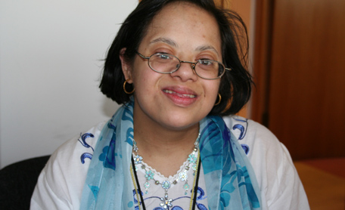
Learning Disabilities – Down’s Syndrome

Slide 35
Learning Disabilities – Down’s Syndrome
Down’s syndrome is one of the best-known causes of a learning disability. It is a genetic condition, resulting from either an extra chromosome or extra genetic material from chromosome 21.
There are three different types of Down’s syndrome: trisomy 21 (the most common type at around 90-95%), translocation (around 3%) and mosaicism (around 1-5%).

Slide 36
Learning Disabilities – Down’s Syndrome
Ask people to ‘define’ a ‘learning disability’, and they will usually describe someone with Down’s Syndrome (DS). This is because people with DS have a distinctive appearance, with eyes that are almond-shaped and slant upwards, together with other physical features including a short neck, a face that is flatter than usual, small hands and feet, short stature, and a tongue that tends to stick out of the mouth. Despite these shared characteristics, people with DS, like all of us, resemble their parents.

Slide 37
Learning Disabilities – Down’s Syndrome
DS is a genetic abnormality, which occurs at conception for unknown reasons. Each person with DS has an extra copy of chromosome 21 in their body’s cells. Apart from a few rare cases, DS is not an inherited disease and can occur in all racial groups. Although the chance of having a baby with DS increases with maternal age, babies with the syndrome are born to mothers of all ages. There is as yet no means of reversing DS, but all pregnant women in England and Wales are now offered screening with the option of termination if tests prove positive for DS. The great majority (92%) choose termination, and the number of lives births with DS in England and Wales is about 750/year, equivalent to one in a thousand live births

Slide 38
Learning Disabilities – Down’s Syndrome
Down’s syndrome affects people in different ways. It is generally associated with cognitive impairment, physical characteristics and certain health issues.
There is a wide range of cognitive impairment, with some young people attending mainstream school and even sitting GCSE exams, and others having a high degree of learning disability.
It is estimated that in developed countries, approximately 1 in 1000 babies are born with Down’s syndrome
in uk 1 in 336 pregnancies and 1 in 854 births
Most babies with Down's syndrome are born to women under 35, but older women are more likely to give birth to a child with the condition.

Slide 39
Learning Disabilities – Down’s Syndrome
Most people with DS have multiple disabilities and health problems.
All people with DS have a learning disability, and the majority also have a range of disabilities and health problems typically associated with the syndrome. Some of these occur from birth, but most are associated with premature ageing, and the health of most people with DS deteriorates sharply after the age of 40 years. About half of all people with DS live beyond 60 years of age.

Slide 40
Learning Disabilities – Down’s Syndrome
Related health issues
People with Down’s syndrome may have a variety of related health issues. Generally, the main health problems are:
Respiratory system – a number of people breathe mainly or solely through their mouths, which can result in sleeping problems (sleep apnoea). Very young children can be more prone to chest infections, but this disposition reduces when they become more active.
Heart – around 40-50% of babies with Down’s syndrome are born with a congenital heart condition, some of which require heart surgery. For more information see the Down’s Heart Group website.
Ears and hearing – hearing problems are common, and this can then affect speech and communication.
Eyes and vision – visual problems again are very common, with many people requiring glasses.

Slide 41
Learning Disabilities – Down’s Syndrome
Thyroid disorders – people may experience overactive or underactive thyroid glands (with underactive being more common) and extra care must be taken to ensure that these are detected.
Ageing – people with Down’s syndrome tend to age earlier and have a greater risk of developing dementia.
Digestive problems. These include constipation, diarrhoea and indigestion, and small bowel obstruction. About one in ten people with DS also develop coeliac disease, which involves an intolerance to gluten.
​Musculoskeletal problems. About one in ten people with DS experience orthopaedic problems, especially with dislocated kneecaps, flat feet, and dislocation of the hip

Slide 42
Learning Disabilities – Down’s Syndrome
People with DS can lead happy and fulfilled lives.
With suitable help and encouragement, people with DS can lead happy and fulfilled lives, with the opportunity to attend normal school and college, move into their own home, find work, and develop friendships and sexual partners. Parents of children with DS can benefit from the advice and support of other parents, and should always be advised to get in touch with the Down’s Syndrome Association. This has details of all local groups of parents of children with DS, and provides information for people with DS, their parents, and professionals.

Slide 43
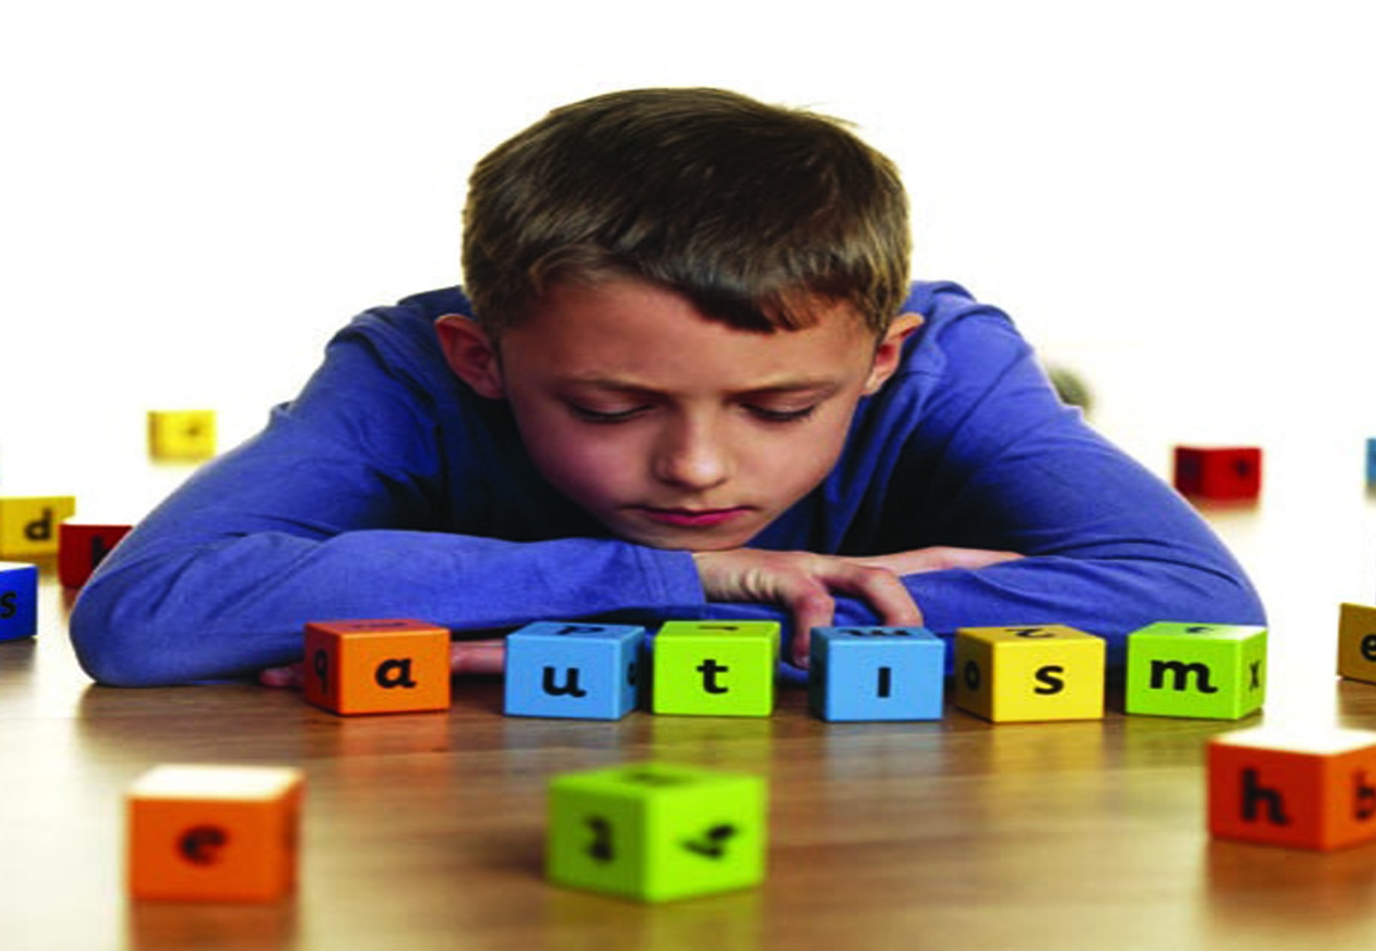
Learning Disabilities - Autism

Slide 44
Learning Disabilities - Autism
Autism is a lifelong condition that includes Asperger Syndrome. Let’s get the language right first. There is Autism Spectrum Disorder or condition, but our view is just to use the term Autism.
Autism affects individuals in different ways, just like having your own unique fingerprints. There is a saying that when you have met one person with Autism then you have met one person only. The causes are a combination of genetics and environmental factors, although research is finding various new theories

Slide 45
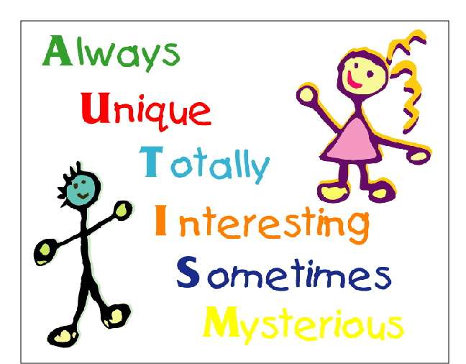
Learning Disabilities - Autism

Slide 46
Learning Disabilities - Autism
As a ‘spectrum disorder’, the symptoms and characteristics of autism can present themselves in a variety of combinations, ranging from extremely mild to severe. All children and adults with an ASD will have the following core symptoms in what is known as the ‘triad’ of impairments:

Slide 47
Learning Disabilities - Autism
Most people with Autism have learning disabilities, also known as Classical Autism whilst those with Asperger Syndrome predominantly do not have a learning disability. The numbers of people with Autism has a progressively changing landscape and this maybe affected by the various diagnostic tools used. The Department of Health estimate that 1% of the population have Autism, this equates to approximately 620,000 people.

Slide 48
Learning Disabilities - Autism
Non-verbal and verbal communication
People with an ASD have difficulty in understanding the communication and language of others, and in communicating themselves.
Many children are delayed in learning to speak and a small minority do not develop much functional speech. This does not mean they cannot communicate, as they use other methods to communicate their needs.
People with an ASD tend to have a literal understanding of language, so the use of metaphors such as ‘it’s raining cats and dogs’ should be avoided

Slide 49
Learning Disabilities - Autism
Social understanding and social behaviour
People with an ASD have difficulty understanding the social behaviour of others and can behave in socially inappropriate ways.
People with an ASD have difficulty empathising with others, and as a result are unable to read social contexts.
Children with an ASD often find it hard to play and communicate with other children, because of their difficulties with empathy

Slide 50
Learning Disabilities - Autism
Imagining and thinking/behaving flexibly
Children with an ASD find it difficult to engage in imaginative play, so they tend to spend more time in solitary play.
Children with an ASD can have an excellent memory concerning toys or activities they are passionate about. People with an ASD tend to have particular interests in specific topics or activities, which they may pursue obsessively.
People with an ASD often find change difficult to cope with, and have a preference for routine. They may also struggle to transfer skills to other activities.

Slide 51
Learning Disabilities - Autism
In addition to the above ‘triad’, some people with an ASD are very sensitive to certain sounds, sights, tastes and textures. This can affect their responses to things like clothes, food or noise. Some people with autism may require 24-hour support, whereas others may be able to lead more independent lives.
Approximately 1% of the population has an autistic spectrum condition.
The prevalence rate of autistic spectrum conditions is higher in men than it is in women (1.8% vs. 0.2%).

Slide 52
Learning Disabilities - Autism
Low Arousal Approach to Autism
Given that stress is an ever present part of the lives of people with autism. How should we manage crisis situations where the individuals we support may be experiencing ‘meltdown’?
McDonnell (2010) identified four key components considered central to low arousal approaches, these include both cognitive and behavioural elements.
Decreasing staff demands and requests to reduce potential points of conflict around an individual. Avoidance of potentially arousing triggers e.g. direct eye contact, touch and removal of spectators to the incident. Avoidance of non-verbal behaviours that may lead to conflict e.g. aggressive postures and stances.
Challenging staff beliefs about the short-term management of challenging behaviours. These apparently simple behaviour management strategies often are difficult to apply in practice as they involve changing our own level of arousal and this requires a practitioner to reflect on their own approach

Slide 53
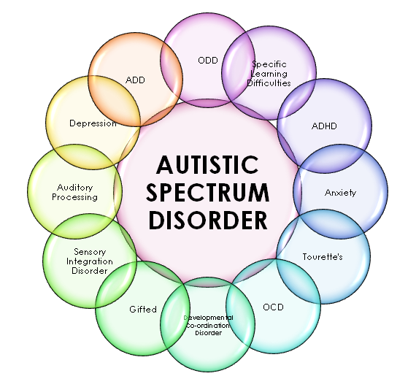
Learning Disabilities - Autism

Slide 54
Learning Disabilities – Asperger Syndrome
Asperger syndrome is part of the autistic spectrum. Having an autistic spectrum disorder means that someone has difficulties in the areas of social interaction, communication and imagination.
It is sometimes referred to as a hidden disability, as it is not usually visible when initially meeting someone with Asperger syndrome.
Asperger syndrome is a life-long condition which is more common in men than women. It is diagnosed in childhood but for some it is often not recognised and diagnosed until adulthood.

Slide 55
Learning Disabilities – Asperger Syndrome
People with Asperger syndrome do not have a learning disability. Most people with Asperger syndrome have gone through mainstream school and some may move into higher education and employment.
Sometimes people will have specialist knowledge and understanding on one or two specific topics, such as I.T or maths. People with Asperger syndrome may excel in some areas, in particular:
Language skills
Memory
Concentration on a preferred activity.

Slide 56
Learning Disabilities – Asperger Syndrome
Some key areas which people with Asperger syndrome may struggle with are:
Understanding metaphors, irony, sarcasm and jokes - they may take things literally and not be able to interpret intonation in speech.
Becoming fixated on particular topics or objects and being unable to move on from them.
Thinking in abstract or hypothetical terms.
Expressing emotion, empathy, sensitivity or tact.
Coping with changes to routines, or adapting to last minute changes.
Making and maintaining friendships.
Social situations.
Hypersensitivity to certain sounds or sensory stimuli, such as noise, smell and light – this can be overwhelming and extremely stressful.

Slide 57
Learning Disabilities – Asperger Syndrome
As a result of the above difficulties affecting everyday life, many people with Asperger syndrome experience mental health problems and can suffer from isolation, depression, anxiety and/or low self-esteem.
Some people may also have an additional learning difficulty such as dyslexia, dyspraxia, or other conditions such as Attention Deficit Hyperactivity Disorder (ADHD) and Obsessive Compulsive Disorder (OCD).
With the right support, people with Asperger syndrome can lead full and independent lives.
The psychologist Tony Attwood, an expert on Asperger syndrome, has described the condition as “a different way of approaching life, one that is dominated by the pursuit of knowledge and truth”.

Slide 58
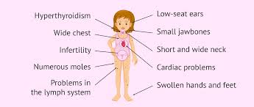
TURNER SYNDROME

Slide 59
TURNER SYNDROME
Turner syndrome, a condition that affects only females, results when one of the X chromosomes (sex chromosomes) is missing or partially missing. Turner syndrome can cause a variety of medical and developmental problems, including short height, failure of the ovaries to develop and heart defects.
Turner syndrome may be diagnosed before birth (prenatally), during infancy or in early childhood. Occasionally, in females with mild signs and symptoms of Turner syndrome, the diagnosis is delayed until the teen or young adult years.
Girls and women with Turner syndrome need ongoing medical care from a variety of specialists. Regular checkups and appropriate care can help most girls and women lead healthy, independent lives.

Slide 60
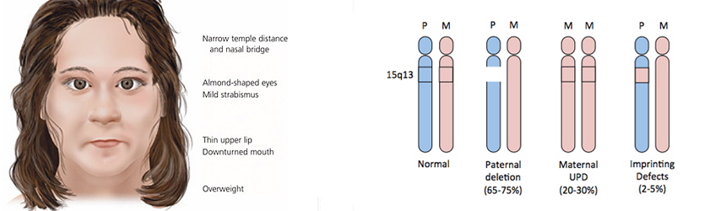
Learning Disabilities – Prada Willie Syndrome

Slide 61
Learning Disabilities – Prada Willie Syndrome
Anyone can be born with Prader-Willi syndrome (PWS). Some individuals may also acquire PWS as a result of trauma to the brain.
PWS is a complex genetic disorder affecting appetite, growth, metabolism, cognitive function and behavior. It is typically characterized by low muscle tone, short stature (when not treated with growth hormone), incomplete sexual development, cognitive disabilities, behavioral problems, and the hallmark characteristics – chronic feelings of insatiable hunger and a slowed metabolism that can lead to excessive eating and life-threatening obesity. Those who have PWS need intervention and strict external controls, sometimes including padlocking access to food, to maintain normal weight and to help save their lives.

Slide 62
Learning Disabilities – Prada Willie Syndrome
It is estimated that one in 12,000 to 15,000 people has PWS. Although considered a “rare” disorder, PWS is one of the most common conditions seen in genetic clinics and is the most common genetic cause of obesity that has been identified to date.
PWS is found in people of both sexes and in all races worldwide.
Most cases of PWS are attributed to a spontaneous genetic error that occurs at or near the time of conception for unknown reasons. In a very small percentage of cases (2 percent or less), a genetic mutation that does not affect the parent is passed on to the child, and in these families, more than one child may be affected. A PWS-like disorder can also be acquired after birth if the hypothalamus portion of the brain becomes damaged through injury or surgery

Slide 63
Learning Disabilities – Prada Willie Syndrome
Basically, the occurrence of PWS is due to lack of several genes on one of an individual’s two chromosome 15′s – the one normally contributed by the father. In the majority of cases, there is a deletion – the critical genes are somehow lost from the chromosome. In some of the remaining cases, the entire chromosome from the father is missing and there are instead two chromosome 15′s from the mother (uniparental disomy). The critical paternal genes lacking in people with PWS have a role in the regulation of appetite. This is an area of active research in a number of laboratories around the world, since understanding this defect may be very helpful not only to those with PWS, but to understanding obesity in otherwise normal people.

Slide 64
Learning Disabilities – Prada Willie Syndrome
People with PWS have a flaw in the hypothalamus part of their brain, which normally registers feelings of hunger and satiety. While the problem is not yet fully understood, it is apparent that people with this flaw never feel full; they have a continuous urge to eat that they cannot learn to control. To compound this problem, people with PWS need less food than their peers without the syndrome because their bodies have less muscle and tend to burn fewer calories

Slide 65
Learning Disability – SYNGAP1
Someone with SYNGAP1 might have a short attention span, be easily distracted, act impulsively or aggressively towards themselves or others. They may also have low muscle tone and an unsteady walk.
Many people with SYNGAP1 might act in a way that is similar to someone with autism, including avoiding eye contact, preferring familiar routines and situations, being sensitive to lights or sounds, and hand flapping or hand biting.
Some people with SYNGAP1 share some mild physical features, including an open mouthed appearance, full eyebrows and increased distance between the eyes. These features are difficult to see in young children, which is why diagnosis can sometimes be delayed.

Slide 66
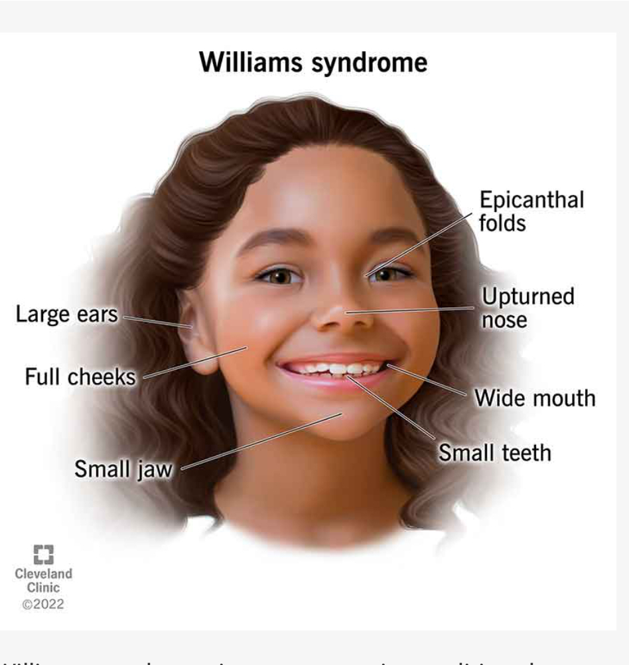
Learning Disability – Williams Syndrome
As well as a learning disability, people with Williams syndrome will often share distinctive facial characteristics including a wide mouth with a pronounced bottom lip, slightly high and rounded cheeks, and widely-spaced teeth.
People with Williams syndrome can develop physical and mental health problems later in life, including anxiety and depression.
People with Williams syndrome are very talkative and can be excessively friendly.

Slide 67
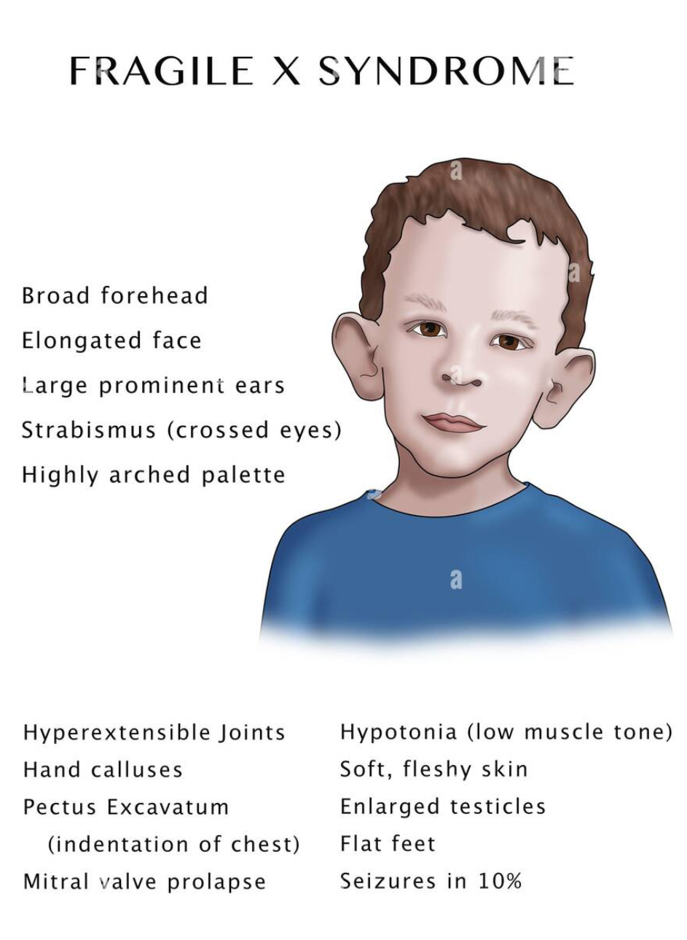
Learning Disabilities - Fragile X
How does Fragile X affect someone?
Someone with Fragile X might have a short attention span, be easily distracted, act impulsively, feel restless, be very active, and have heightened senses, but no two people are the same.
Many people with Fragile X might act in a way that is similar to someone with autism, including avoiding eye contact, feeling anxious in social situations, extreme shyness, enjoying familiar routines and hand flapping or hand biting.
People with Fragile X share some physical features, including a long narrow face with prominent jaw bones and ears. These features are difficult to see in young children, which is why diagnosis can sometimes be delayed.

Slide 68
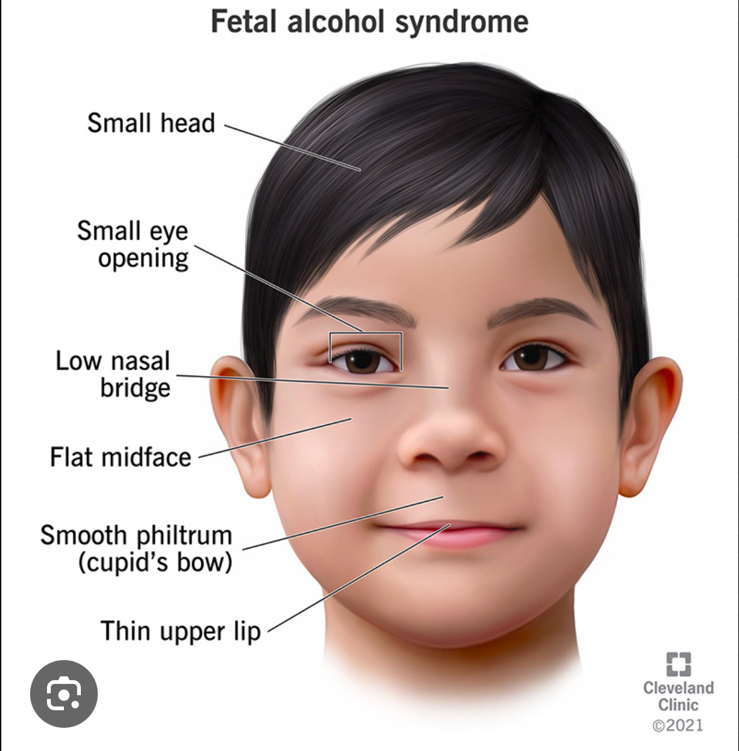
Learning Disabilities-Fetal Alcohol Spectrum Disorders
FASD is emerging as the most common source of life dysfunction, and by far the least recognized
Occur in between 2 and 5% of the population.
Can produce symptoms of Bipolar Disorder, AD/HD, Autism Spectrum Disorders, Learning Disabilities, Reactive Attachment Disorders–among others.
Go almost entirely unrecognized*, as most people with FASD have normal IQ, speech and appearance. Only a small fraction have the facial features of Fetal Alcohol Syndrome.

Slide 69
Learning Disabilities-Fetal Alcohol Spectrum Disorders
Range widely in severity and presentation from mental retardation to mild attention, learning or social problems. Almost always impair reasoning, planning, judgment and memory. Frequently cause sensory disturbance.
Do not respond to normal parenting/teaching approaches. Without diagnosis and support, parents feel crazy, ashamed and exhausted, as the rest of the world freely offers its criticism and incorrect (and contradictory) remedies to distressing behavior.
Cause undiagnosed people with FASD to feel crazy, ashamed and exhausted because they consistently do not meet expectations (including their own) even though they may be trying their very hardest.
Learning Disabilities

Slide 70
Learning Disabilities-Fetal Alcohol Spectrum Disorders
Fill our jails and prisons, homeless shelters and hospital emergency rooms, chronic welfare caseloads and substance abuse centers.
Are particularly common in foster care, where there is additional complication from trauma and neglect.
When recognized and appropriately addressed**, can be managed so the that the person’s true gifts have a chance to bloom
ARE–THIS SHOULD GO WITHOUT SAYING–ENTIRELY PREVENTABLE. Exactly how much alcohol it takes to cause damage depends on a combination of genetics, other substances and life circumstances of the mother. It is ALWAYS a gamble…not unlike Russian Roulette. Studies show that impairments can result from very modest drinking

