Slide 1
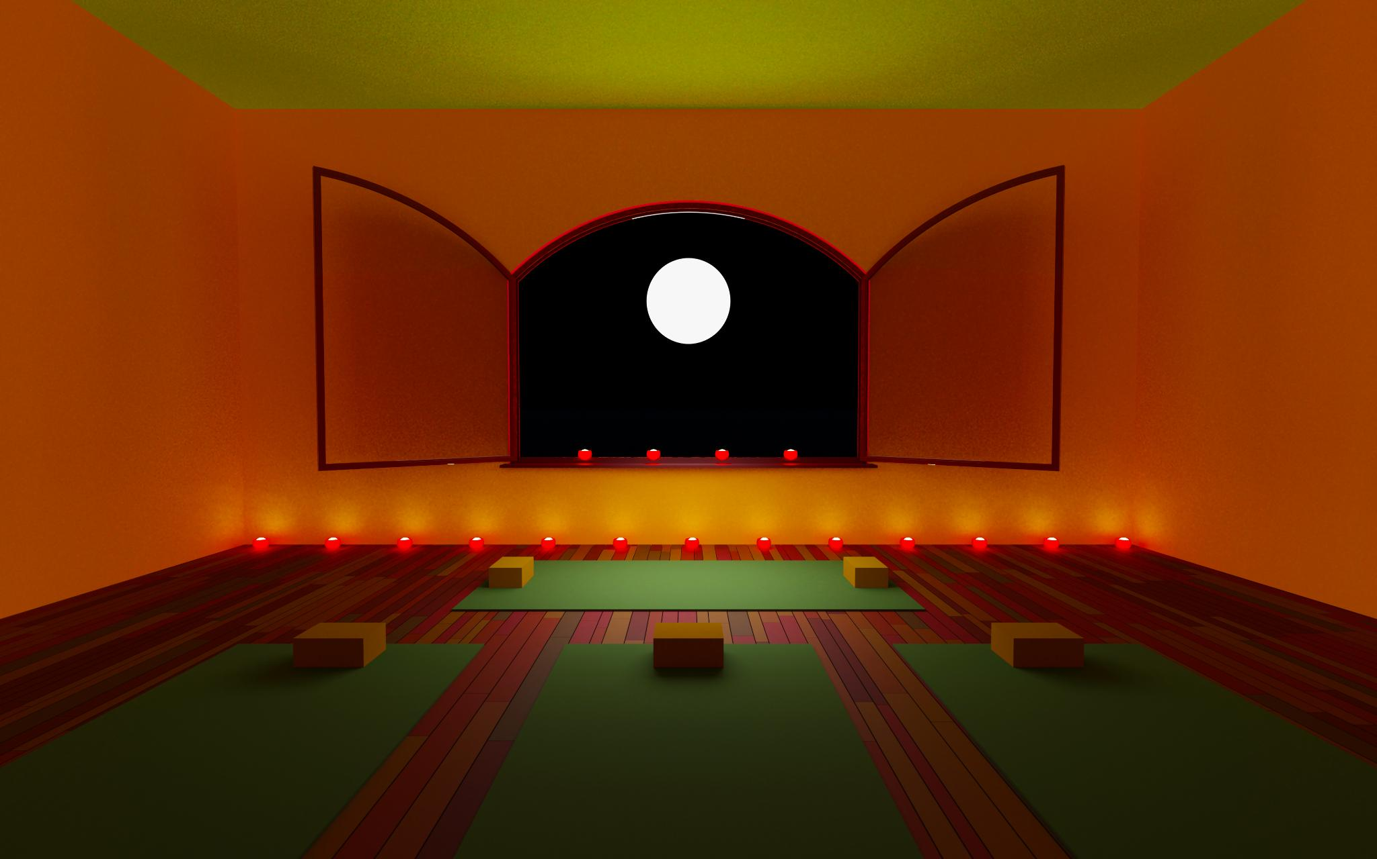
Intense Interaction Autism and Multi-Sensory Integration: Enhancing Communication and Development
Exploring strategies for autism communication enhancement
Notes:
---
This presentation focuses on the relationship between intense interaction approaches and multi-sensory integration in the context of Autism Spectrum Disorder (ASD). We will explore how these concepts can enhance communication and support the development of individuals with autism.

Slide 2

Agenda Overview
Overview of Autism Spectrum Disorder (ASD)
Intense Interaction Approach
Multi-Sensory Integration (MSI) and Autism
Combining Intense Interaction and MSI
Benefits and Outcomes
Future Directions and Research
Notes:
We will begin by providing an overview of Autism Spectrum Disorder, including its characteristics and diagnostic criteria. Next, we will delve into the intense interaction approach, its principles, history, and techniques. We will then discuss multi-sensory integration, its importance, and challenges for individuals with autism. Finally, we will explore the synergy between these methods and their benefits.

Slide 3
Overview of Autism Spectrum Disorder (ASD)
Notes:
Understanding Autism Spectrum Disorder is essential for effective communication and development strategies. ASD is a complex neurodevelopmental disorder that affects how individuals perceive the world and interact with others.

Slide 4

Understanding Autism Spectrum Disorder
Difficulties in Social Interaction
  Individuals with ASD often face challenges in social interactions, affecting their ability to connect with others.
Communication Challenges
  Communication can be particularly challenging for those on the autism spectrum, leading to unique expressions and interactions.
Unique Profiles of Abilities
  Each individual with autism has a distinct profile of abilities and challenges, highlighting the spectrum nature of the disorder.
Notes:
ASD encompasses a range of developmental disorders characterized by difficulties in social interaction, communication, and repetitive behaviours. Each individual with autism presents a unique profile of abilities and challenges.

Slide 5
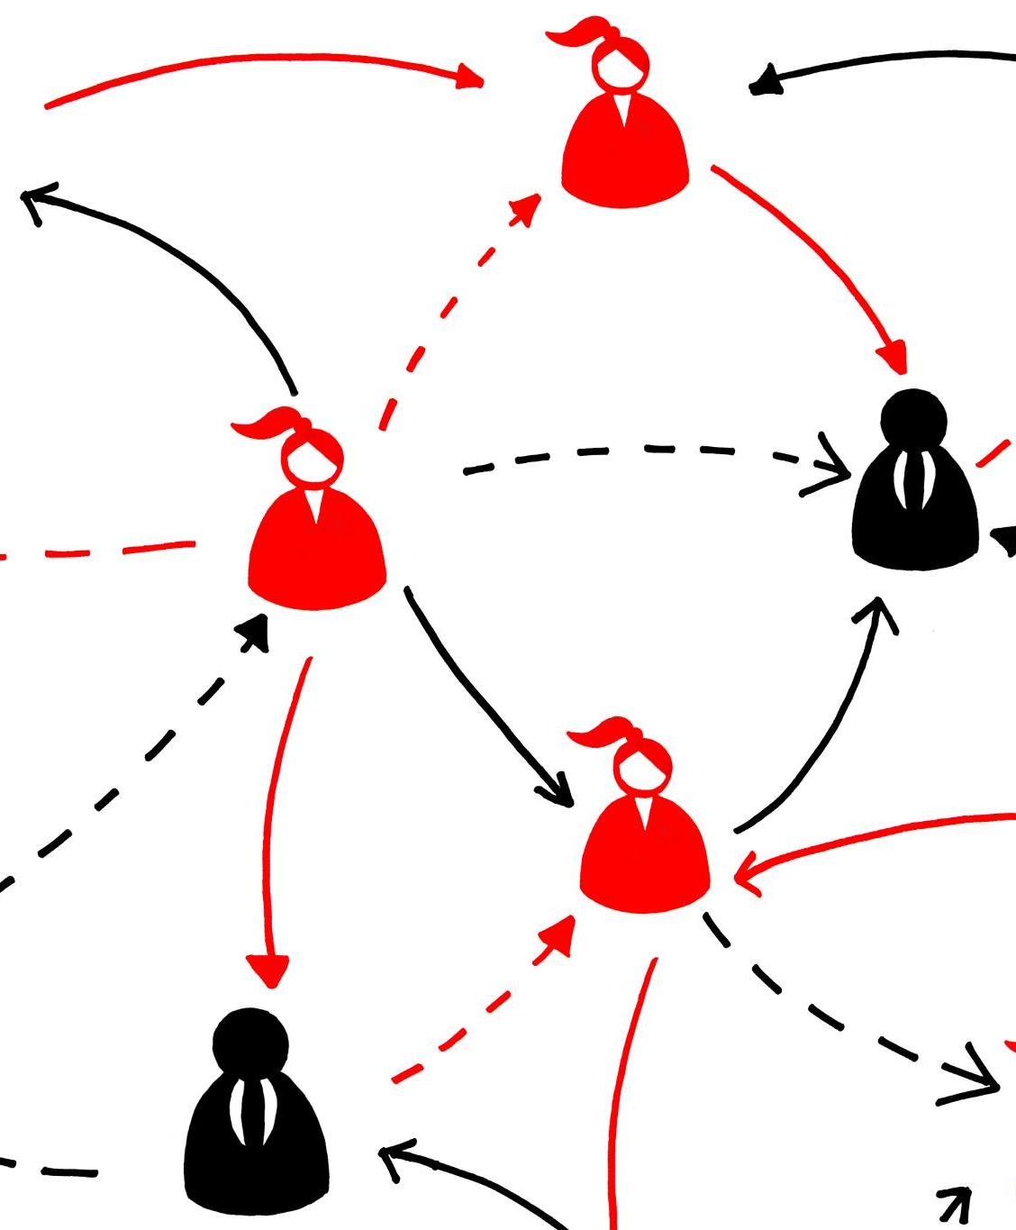
Characteristics and challenges
Communication Challenges
  Individuals with ASD often face difficulties in both verbal and non-verbal communication, affecting their interactions.
Understanding Social Cues
  Many individuals with ASD struggle to interpret social cues, which can lead to misunderstandings in social situations.
Sensory Processing Issues
  Sensory processing issues can cause individuals with ASD to experience overwhelming reactions to sensory stimuli.
Notes:
Common characteristics of ASD include challenges in verbal and non-verbal communication, difficulties in understanding social cues, and sensory processing issues. These challenges can significantly impact daily functioning and quality of life.

Slide 6
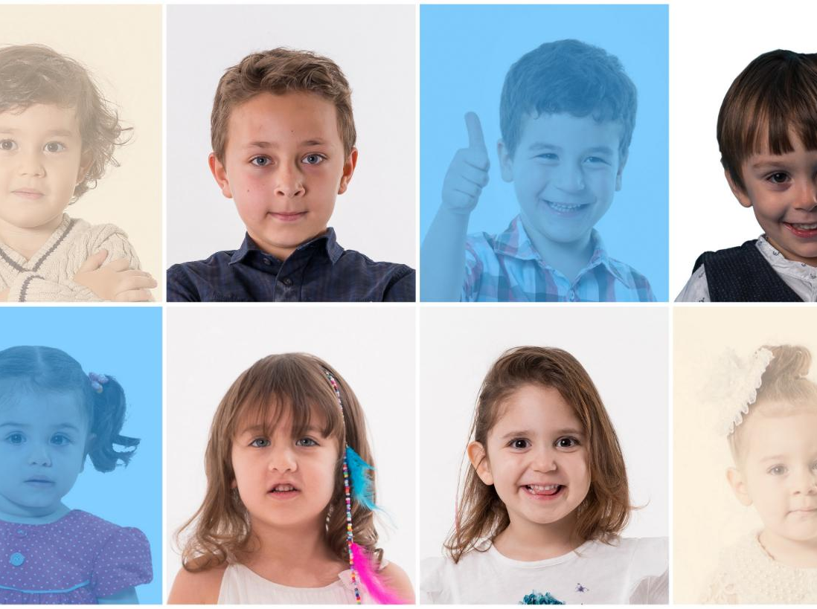
Prevalence and diagnosis criteria
Increase in Prevalence
  Recent studies indicate a notable rise in the prevalence of ASD across various populations, highlighting the need for awareness.
Diagnosis Criteria Overview
  Diagnosis of ASD is based on specific criteria outlined in the DSM-5, focusing on communication and behaviour.
Social Communication Deficits
  A key diagnostic criterion is the presence of social communication deficits that affect daily functioning.
Restricted and Repetitive Behaviors
  Individuals with ASD may exhibit restricted and repetitive behaviours, which are significant for diagnosis.
Notes:
The prevalence of ASD has increased in recent years, with varied estimates across different populations. Diagnosis is based on specific criteria outlined in the DSM-5, which focus on social communication deficits and restricted, repetitive behaviours.

Slide 7
Intense Interaction Approach
Notes:
The Intense Interaction Approach is a communication method designed to support individuals with profound and multiple learning disabilities, including those with autism. This approach emphasises building relationships through meaningful interactions.

Slide 8

Principles of Intense Interaction
Focus on Individual Interests
  Emphasizing the individual's interests fosters deeper engagement and connection in the interaction process.
Non-Verbal Communication
  Utilizing non-verbal cues enhances understanding and emotional connection, making interactions more effective.
Adapting to Sensory Preferences
  Tailoring interactions to meet sensory preferences creates comfort and encourages participation from individuals.
Notes:
Key principles of intense interaction include focusing on the individual's interests, using non-verbal communication, and adapting to their sensory preferences. This creates a safe space for engagement and learning.

Slide 9

History and development of the method
Origins in the 1980s
  The intense interaction method was developed in the 1980s and has since evolved significantly through ongoing research and practice.
Theoretical Foundations
  The method draws on various theories of communication and social interaction, helping to shape its effective strategies.
Connecting with Autism
  The intense interaction method is designed specifically to enhance connection and engagement with individuals with autism.
Notes:
Developed in the 1980s, the intense interaction method has evolved through practice and research. It draws on theories of communication and social interaction to create effective strategies for connecting with individuals with autism.

Slide 10

Key techniques and strategies
Mirroring Technique
  Mirroring is an effective technique that involves reflecting another person's actions or speech, enhancing connection and understanding.
Turn-Taking
  Turn-taking is a strategy that encourages balanced interaction by allowing participants to take turns in communication, fostering active engagement.
Sensory-Rich Activities
  Sensory-rich activities involve engaging multiple senses to enhance learning and communication, making interactions more dynamic and memorable.
Notes:
Techniques such as mirroring, turn-taking, and sensory-rich activities are fundamental to the intense interaction approach. These strategies foster engagement and build communication skills over time.

Slide 11
Multi-Sensory Integration (MSI) and Autism
Notes:
Multi-sensory integration is crucial for individuals with autism, as it involves processing and integrating information from multiple senses. Understanding this concept can enhance communication and learning.

Slide 12

Introduction to multi-sensory integration
Definition of MSI
  Multi-sensory integration (MSI) refers to the brain's ability to combine information from different sensory modalities, enhancing perception.
Importance of MSI
  MSI is crucial for effective communication skills, allowing individuals to process and respond to sensory information accurately.
Role in Social Interaction
  The ability to integrate sensory information is vital for social interaction, as it helps interpret social cues and emotions.
Notes:
MSI is the brain's ability to combine information from different sensory modalities, such as sight, sound, and touch. This process is essential for developing effective communication skills and social interaction.

Slide 13

Importance of MSI in Development
Cognitive Development
  Multi-sensory integration (MSI) plays a crucial role in enhancing cognitive development, facilitating better information processing.
Emotional Development
  Effective MSI supports emotional development, allowing individuals to better understand and express their feelings.
Benefits for Individuals with Autism
  Enhancing MSI for individuals with autism can significantly improve their engagement, learning capabilities, and social interactions.
Notes:
Effective multi-sensory integration is vital for cognitive and emotional development. For individuals with autism, enhancing MSI can lead to improved engagement, learning, and social interaction.

Slide 14

Challenges faced by individuals with autism
Sensory Processing Challenges
  Individuals with autism may experience difficulties in processing sensory information, which can lead to sensory overload.
Communication Difficulties
  Many individuals with autism face challenges in communication, affecting their ability to express needs and emotions.
Social Skills Challenges
  Social interactions can be difficult for individuals with autism, impacting their ability to form relationships.
Notes:
Individuals with autism often experience sensory processing challenges, leading to difficulties in integrating sensory information. This can result in overwhelming experiences and hinder communication and social skills.

Slide 15
Combining Intense Interaction and MSI
Notes:
Combining the intense interaction approach with multi-sensory integration strategies can create powerful learning experiences for individuals with autism. This synergy supports communication and development.

Slide 16
Synergy between Intense Interaction and MSI
Holistic Communication Framework
The integration of intense interaction and MSI offers a comprehensive approach to communication, fostering deeper connections.
Enhanced Engagement Strategies
Combining intense interaction with MSI leads to improved engagement strategies that resonate with diverse audiences.
Effective Interventions
Practitioners can leverage the strengths of both methods to create more effective interventions in various contexts.
Notes:
The combination of intense interaction and MSI creates a holistic framework for communication and engagement. By harnessing the strengths of both methods, practitioners can enhance the effectiveness of their interventions.

Slide 17
Case studies and success stories
Educational Applications
Intense interaction techniques have been successfully applied in educational settings, leading to enhanced learning experiences and engagement.
Therapeutic Settings
MSI has shown significant effectiveness in therapeutic environments, improving the communication skills of individuals with special needs.
Communication Skills Improvement
Case studies indicate that both intense interaction and MSI contribute to remarkable enhancements in communication and social skills.
Notes:
There are numerous examples of successful applications of intense interaction and MSI in educational and therapeutic settings. These case studies highlight significant improvements in communication and social skills.

Slide 18
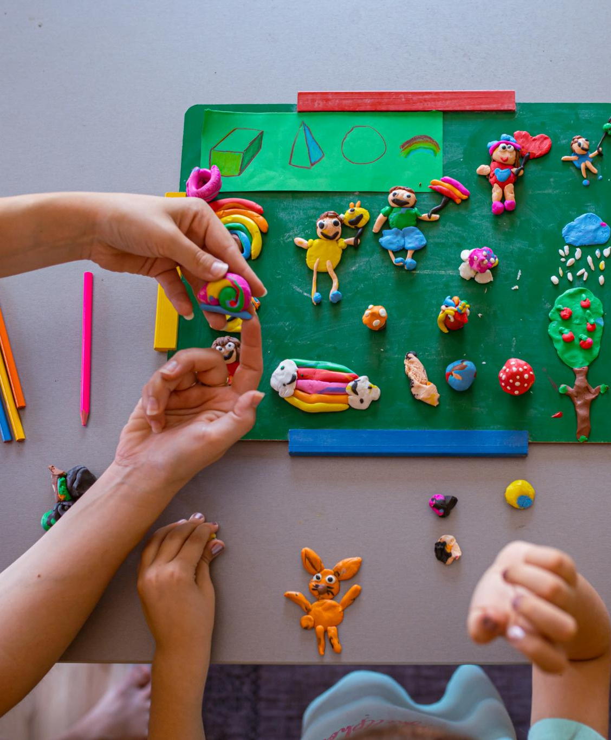
Practical applications and techniques
Sensory-Rich Environments
  Creating sensory-rich environments can enhance learning and interaction by stimulating the senses and engaging participants.
Tailored Communication Strategies
  Utilising tailored communication strategies ensures effective information delivery, catering to individual needs and preferences.
Engaging Activities
  Incorporating engaging activities fosters interaction among participants, promoting collaboration and enhancing learning experiences.
Notes:
Practical applications include using sensory-rich environments, tailored communication strategies, and engaging activities to foster interaction. Implementing these techniques can lead to meaningful outcomes.

Slide 19
Benefits and Outcomes
Notes:
The integration of intense interaction and multi-sensory methods has numerous benefits, including improved communication skills and enhanced social engagement. These positive changes can greatly impact individuals' lives.

Slide 20

Improved Communication Skills
Verbal Communication
  Intense interaction enhances verbal communication skills, allowing individuals to express themselves more effectively.
Non-Verbal Communication
  Improved non-verbal communication skills help individuals read body language and expressions, fostering deeper connections.
Enhanced Relationships
  Better communication skills lead to stronger relationships and enhanced understanding among individuals.
Notes:
Engaging with individuals through intense interaction and MSI can lead to improved verbal and non-verbal communication skills. This enhanced communication fosters better relationships and understanding.

Slide 21

Enhanced Social Interaction
Meaningful Interactions
  Promoting meaningful interactions helps individuals with autism develop vital social skills necessary for effective communication.
Improved Social Skills
  As social skills improve, individuals with autism can build more fulfilling relationships with peers and family members.
Participation in Social Settings
  Enhanced social skills lead to greater participation in various social settings, fostering inclusivity and belonging.
Notes:
By promoting meaningful interactions, individuals with autism can experience improved social skills, leading to more fulfilling relationships and enhanced participation in social settings.

Slide 22

Positive Behavioural Changes
Integrated Approaches
  Implementing integrated approaches can effectively facilitate positive behavioural changes in individuals, promoting healthier interactions.
Reducing Challenging Behaviours
  Through these approaches, challenging behaviours can be significantly reduced, leading to more constructive social interactions.
Increased Engagement
  These methods encourage individuals to engage more in activities, enhancing their overall quality of life and satisfaction.
Notes:
The use of these integrated approaches can result in positive behavioural changes, reducing challenging behaviours and increasing engagement in activities. This leads to a higher quality of life.

Slide 23
Future Directions and Research
Notes:
The field of autism research is constantly evolving. Future directions will focus on enhancing interventions and exploring new strategies for combining intense interaction with multi-sensory integration.

Slide 24
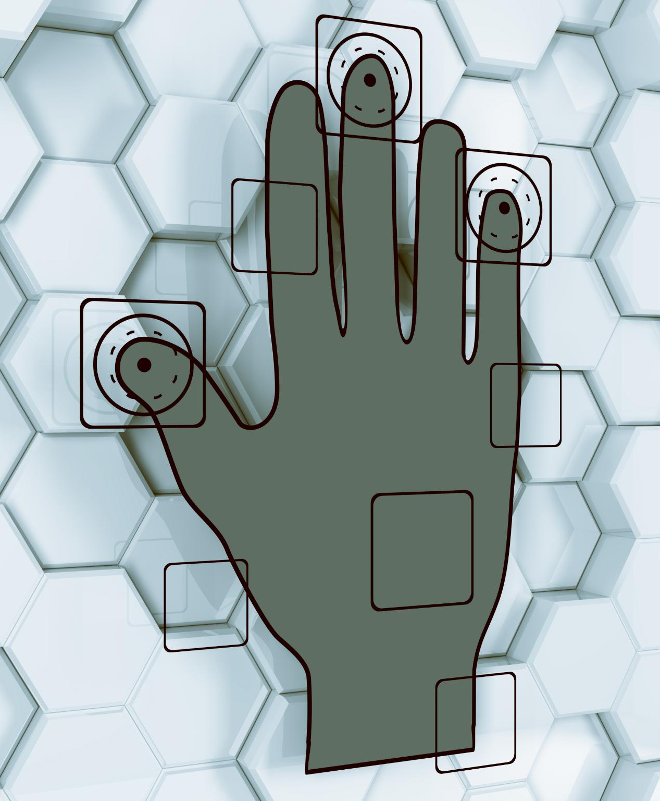
Current research and findings
Effectiveness of Interaction
  Recent studies highlight the effectiveness of combining intense interaction with various sensory modalities for improved learning outcomes.
Multi-Sensory Integration
  Research indicates that multi-sensory integration can enhance engagement and retention by stimulating different senses simultaneously.
Ongoing Research
  Exploration of best practices and techniques continues to advance understanding of effective teaching and learning strategies.
Notes:
Recent studies have shown promising results in the effectiveness of combining intense interaction and multi-sensory integration. Research continues to explore best practices and techniques.

Slide 25
Potential Advancements and Innovations
Emerging Technologies
  Innovative technologies are being developed to enhance communication for individuals with autism, fostering better understanding and interaction.
Innovative Approaches
  New strategies and techniques are being explored to tailor interventions that meet the unique needs of individuals with autism.
Improving Intervention Strategies
  Advancements in technology promise to refine and enhance existing intervention strategies, leading to improved outcomes.
Notes:
Emerging technologies and innovative approaches are being explored to enhance communication and support individuals with autism. These advancements promise to improve intervention strategies.

Slide 26

Implications for therapy and education
Intense Interaction Techniques
  Intense interaction techniques can enhance communication and engagement for individuals with autism, fostering deeper connections.
Multi-Sensory Strategies
  Multi-sensory strategies incorporate various senses to create a more immersive learning experience, benefiting individuals with diverse needs.
Tailored Interventions
  Professionals can customize interventions based on individual needs, improving effectiveness and outcomes for those with autism.
Notes:
The integration of intense interaction and multi-sensory strategies has significant implications for therapy and educational settings. Professionals can tailor interventions to meet the needs of individuals with autism.

Slide 27
Conclusion
Intense Interaction
Intense interaction techniques provide engaging ways to enhance communication in individuals with autism, fostering connections and understanding.
Multi-Sensory Integration
Multi-sensory integration helps individuals with autism process information more effectively, leading to improved communication and development.
Effective Interventions
By embracing these approaches, we can create more effective interventions and support systems tailored for individuals with autism.
Notes:
In conclusion, the combination of intense interaction and multi-sensory integration offers new opportunities for enhancing communication and development in individuals with autism. By embracing these approaches, we can create more effective interventions and support systems.

